Slide 1
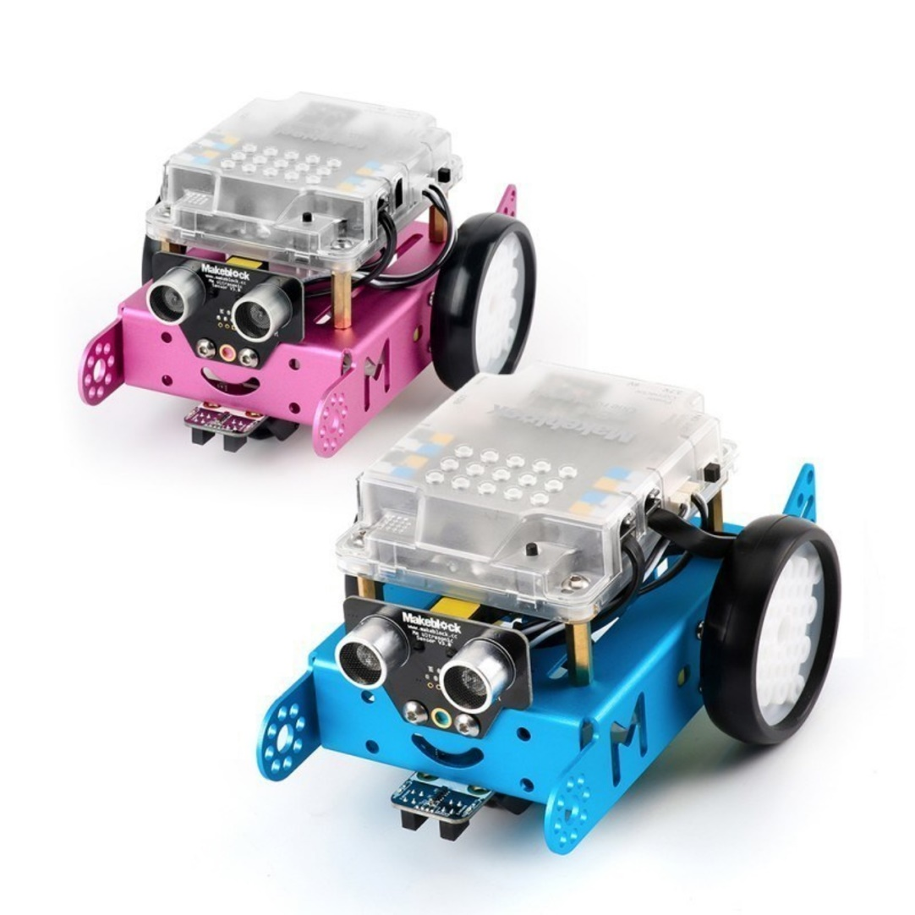
mBot Crasher Arcade Game
A real time strategy car crashing game

Slide 2
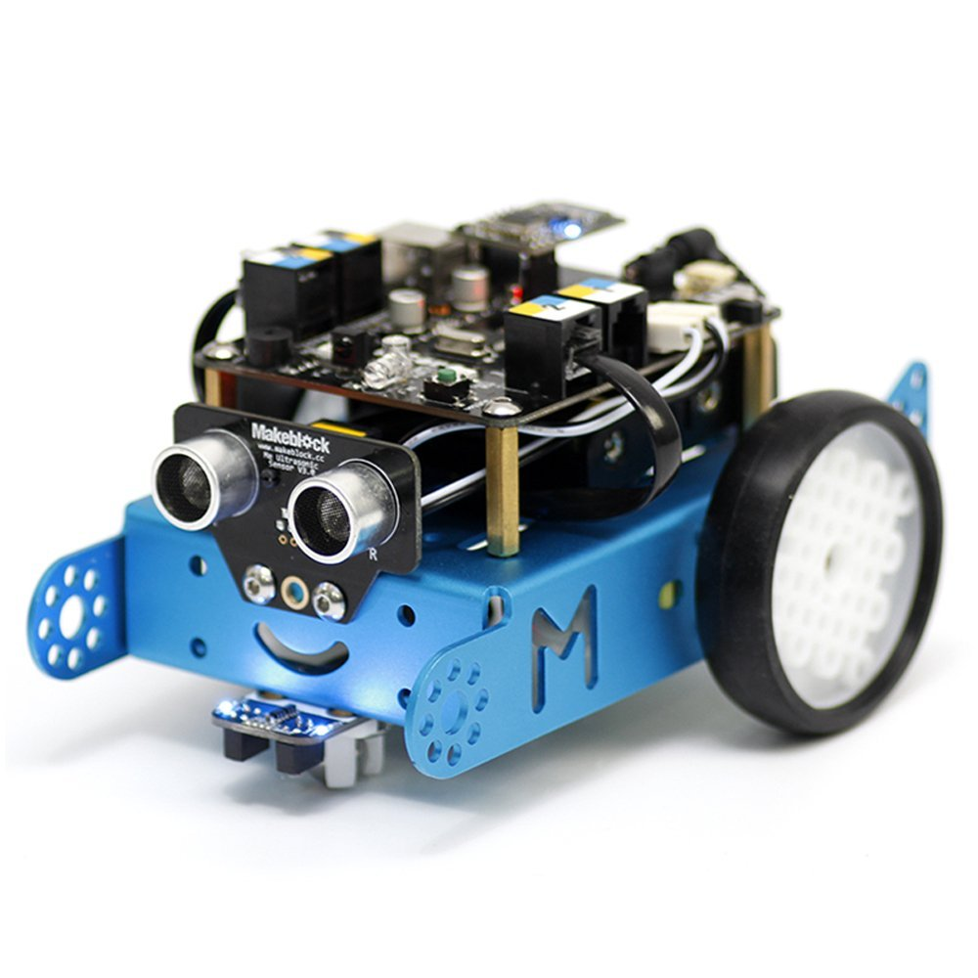
Rules of mBot Crasher
NOTE:
To change images on this slide, select a picture and delete it. Then click the Insert Picture icon
in the placeholder to insert your own image.

Slide 3
Rules of mBot Crasher
Each player control an mBot by an infrared controller.
Each mBot has a point system. One earns points by crashing to other by the front of one’s mBot, or collect black dots on the table.
As point goes up, the sound will be more frequent.
When one achieve max points, the led will turn green and his/her mBot will celebrate with a winning melody!
Each person is equipped with virtual reality glass connected to the view of the the mBot’s front view.

Slide 4

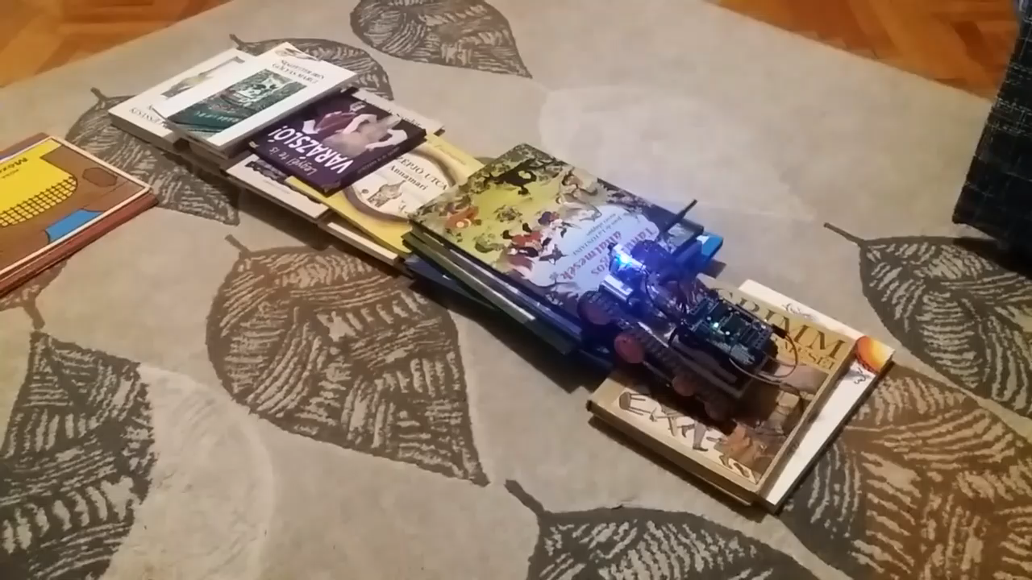
Virtual reality in development

Slide 5

Strategy to win mBot Crasher

Slide 6
Strategy to win mBot Crasher
Try to hit into the opponent’s back or side, so that they cannot also gain points with you.
When the opponent is collecting black dots, stop them by crashing into them.
Try doing a wheelie to dodge the attack.
You also gain points as you step on other’s mBot.

Slide 7
Data table
By sigmoid function, the starting point is 0, the maximum point is one.
This is the data table comparing each strategy and points earned.
Choose your strategy wisely.
Second | Crashing | Collecting
1 | 0.25 | 0.10
2 | 0.50 | 0.15
5 | 1.25 | 0.55

Slide 8
Technology behind
What I use?

Slide 9
Infrared controller
Ultrasonic sensor
Color sensor
Data processor

Slide 10
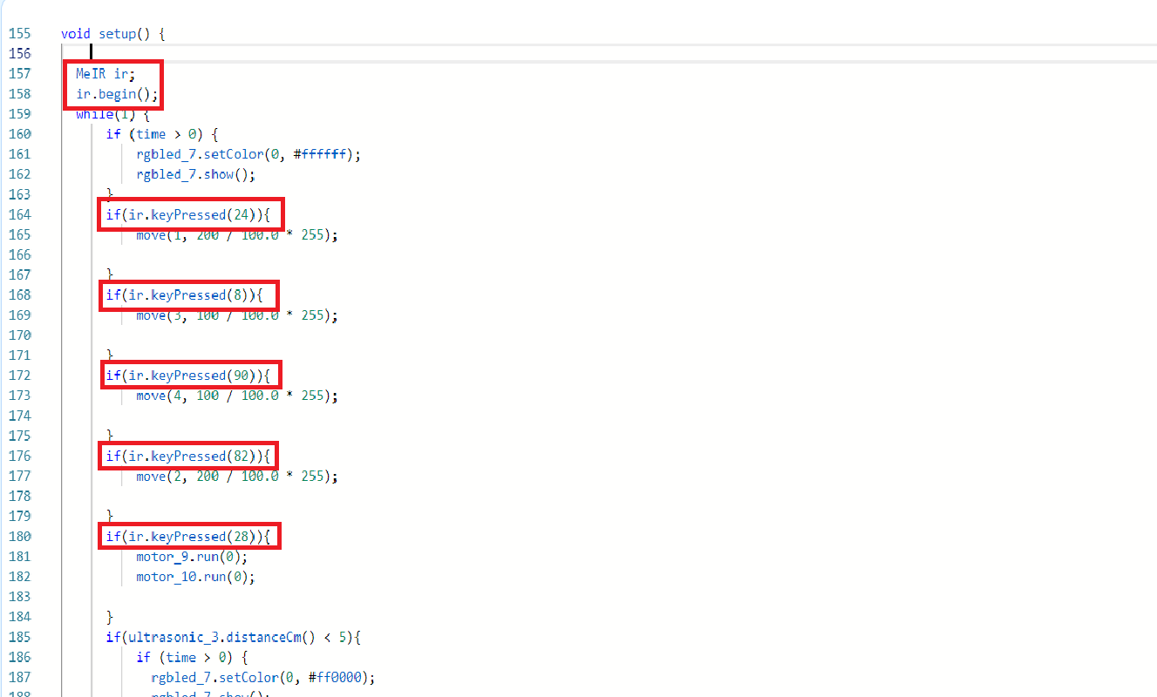
Infrared controller

Slide 11
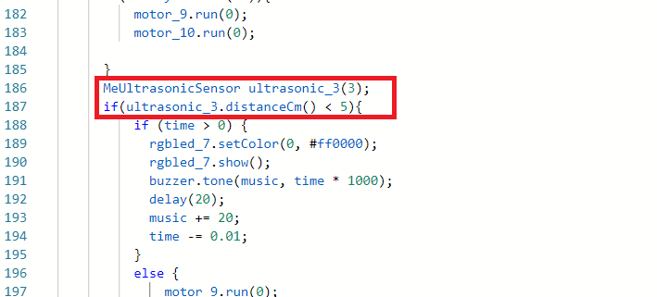
Ultrasonic sensor

Slide 12
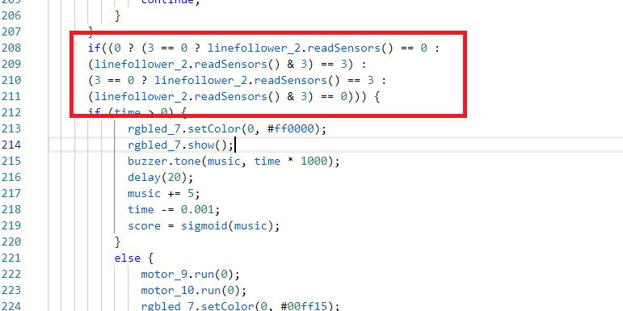
Color sensor

Slide 13
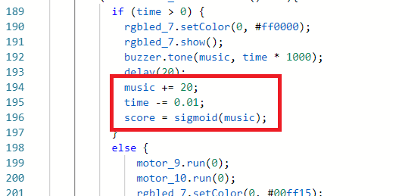
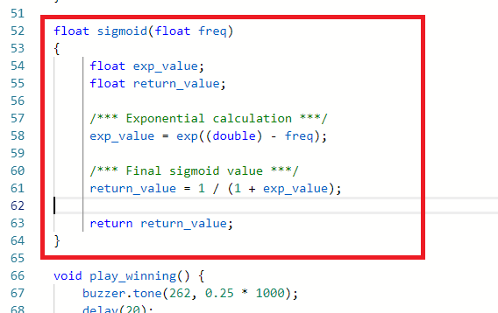
Data processor

Slide 14

Data processor
Sigmoid Function

Slide 15
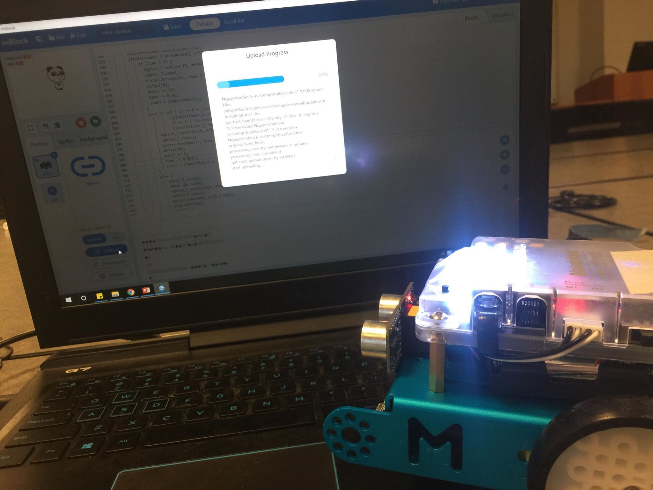
Thank you very much!
Enjoy the game!

